Slide 1
ADS Project 4: Association mining of music and text
Presentator: Yu Qin

Slide 2
Basic Information
2350 h5 files (songs)
16 features for each song
Lyric matrix
5000 words dictionary
How can we get accurate prediction from music features to lyrics?

Slide 3
Contents
Topic Model: Extract infomation from lyrics
Feature Selection
i) Cut-off and Repeat
ii) Dimension Subtraction :PCA
Associated Patterns
i) Gradient Boosting Machine
ii) Ridge Regression
iii) Random Forest
Problem & Way to improve

Slide 4
Topic Model
Delete some words, use 4973 words in total
Bulid 20-topics topic model, with Latent Dirichlet Allocation & Gibbs method
Caculate probability matrixs
every word for each topic, 4973×20
every topic for each song, 20×2350
Expected results are linear combinations of 20 topics

Slide 5
Feature Selection
First-cut
Only use "segments_loudness_max”,"segments_loudness_max_time", "segments_loudness_start", "segments_pitches", "segments_start", "segments_timbre" features for each song

Slide 6
Feature Selection
Use cut-off or repeat method to make every length of feature of every song is 1375
5%-95% quantile of the feature length is 340.75-1375
Treat the matrix-value feature as several individual features
28×1375 matrix for each song
Model fitting requirement
Remain most of the infomation

Slide 7
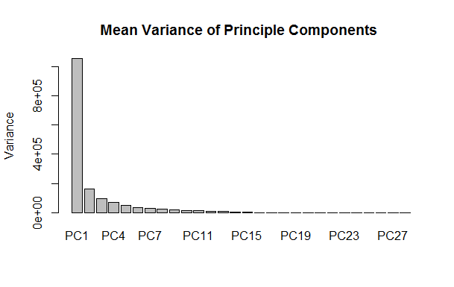
Feature Selection
PCA Method
Use the first principle component only for each song
Time-cost & Infomation trade-off
Space limitation
2350×1375 matrix as observation matrix

Slide 8
Feature Selection
h5 file(song)
First-cut 6 features cut-off &repeat 28×1375 matrix
PCA 1×1375 vector
2350×1375 observation matrix

Slide 9
Association Patterns
Unbalanced number of parameters & number of observations
n/p <5
Gradient Boosting Machine, Random Forest & Ridge Regression
Predict results are probabilitity vectors for fitting all 20 topics

Slide 10
Association Patterns
Gradient Boosting Machine
Use topic cluster results as train data label
Consider multinomial distribution
Tune shrinkage=0.1
Time cost: 144.59s

Slide 11
Association Patterns
Random Forest
Use topic cluster results as train data label
Cross-vaildation
Time cost: 120.17s

Slide 12
Association Patterns
Ridge Regression
Multi-Gaussian Method
Use probability matrix as train data response
Tune for optimal lambda
Time cost: 2518.43s + 0.95s

Slide 13
Association Patterns
Test Results (80% train data, 20% test data)
 | Evaluation rate(mean) | Evaluation rate(median) | 5% quantile | 95% quantile | Variance | Training time cost(s)
GBM | 0.2839 | 0.2413 | 0.1228 | 0.6331 | 0.02960 | 144.59
Random Forest | 0.2675 | 0.2512 | 0.1312 | 0.5983 | 0.03148 | 120.17
Ridge regression | 0.2438 | 0.2020 | 0.0977 | 0.5384 | 0.02321 | 2519.38

Slide 14
Problem & Way to improve
Too many infomation loss in feature selection part
cut-off + PCA
KNN or other data compression methods
Test results can be improved
New Associated Patterns : deep learning or other supervised methods
More than topic model
N-gram model or HMM
Sensitive test

Slide 15
Thanks!

Slide 16
Q&A

